Slide 1

The Machine Learning Process
Python 101 – Advance Python Objects and Data Structures
Sathish Ravichandran

Slide 2



Advance Numbers
hex(number) – convert number to hexadecimal
bin(number) – convert number to binary
pow()
Notes:
hex(246)
bin(1234)
pow(2,4)

Slide 3
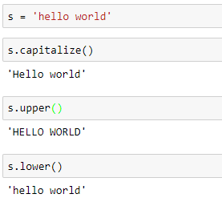
Advance Strings
Changing case
Notes:
s = 'hello world’
s.capitalize()
s.upper()
s.lower()

Slide 4
Thank you
The Capacity to learn is a gift;
The ability to learn is a skill;
The willingness to learn is a choice.
-Brian Herbert

